Slide 1
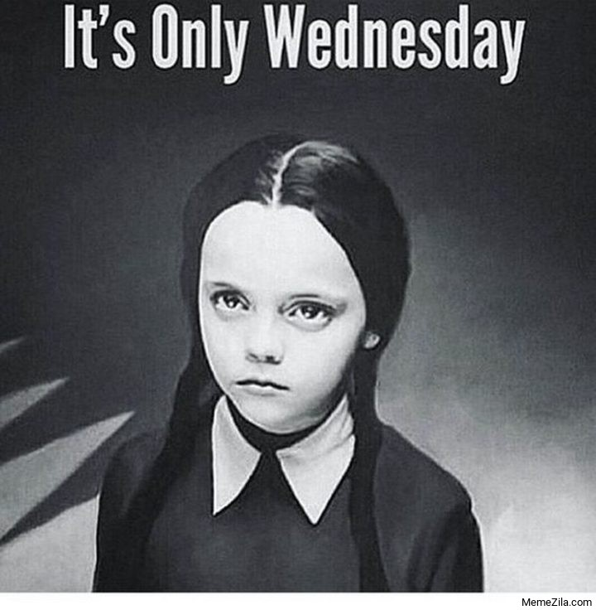
Here we go

Slide 2
Changes on Canvas
Access lecture materials

Slide 3




Asking Goods Questions
Notes:
Chapter 12

Slide 4
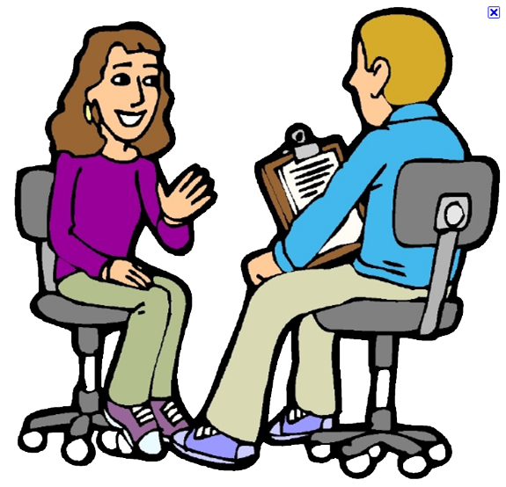
iClicker Question
Customer intention is a great indicator of future sales. We can just ask customers for their purchase intention to plan ahead.
Agree
Disagree
This Photo by Unknown Author is licensed under CC BY-NC

Slide 5
iClicker Question
Why do we need to implement disguised observation?
To avoid desirability bias
To avoid asking respondents for their consent
Both A and B

Slide 6
iClicker Question
It’s okay to use disguised observation or communication and we don’t need to debrief afterward so that we can collect accurate data without desirability bias.
Agree
Disagree

Slide 7

iClicker Question
What is the trade-off between personal Interviews and mail/online surveys?
Flexibility vs. interviewer bias
Response rate vs. Cost
Both A and B

Slide 8
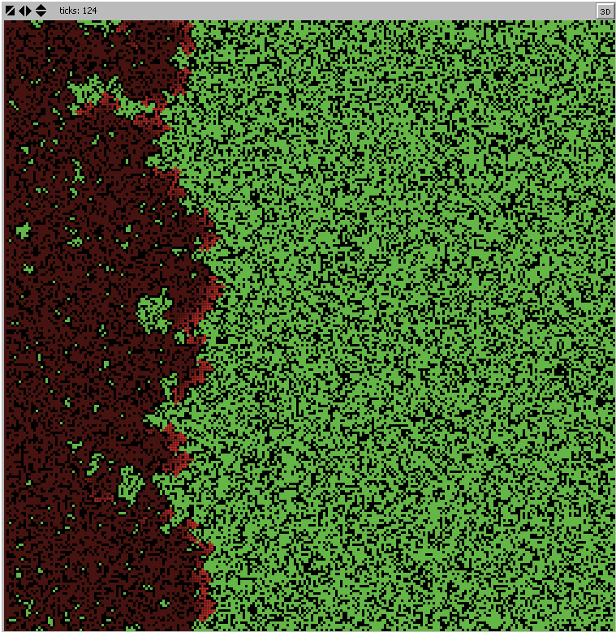
iClicker Question
From the Fire Simulation, we see that it’s bad to have prescribed burning (to reduce density).
TRUE
FALSE

Slide 9

Recap Last Class
Chapter 9: Types of Primary Data
Chapter 10: Observation
Degree of structure
Degree of Disguise
Setting
Method of Administration
Chapter 11: Communication
Degree of Structure
Degree of Disguise
Method of Administration
Notes:
Ask you to name 7 types of primary data
Demographic/socioeconomic characteristics
Personality/lifestyle characteristics
Attitudes
Awareness/knowledge
Intentions
Motivation
Behavior
Degree of structure;: structured vs. unstructured
Degree of Disguise: undisguised vs. Disguised
Setting: natural vs. Contrived
Method of Administration: Human vs. Mechanical
Degree of structure: structured vs. unstructured
Degree of disguise: undisguised vs. disguised
Method of Administration: personal, telephone, mail, and online survey

Slide 10

Fraud Detection
Benford’s law
Gap analysis
Matching algorithm
Notes:
Before we get to today’s materials, I’d like to introduce you to one of many data detective or fraud detection toolkits: Benford’s law.
In the last class, I was met with some skeptical and critical eyes when I mention that data detectives can know if you fake data. I think it makes sense, that if a guy just tells me that he knows if I am lying, I probably wouldn’t trust him either. However, we will see if this is possible.
Go to the Rscript

Slide 11
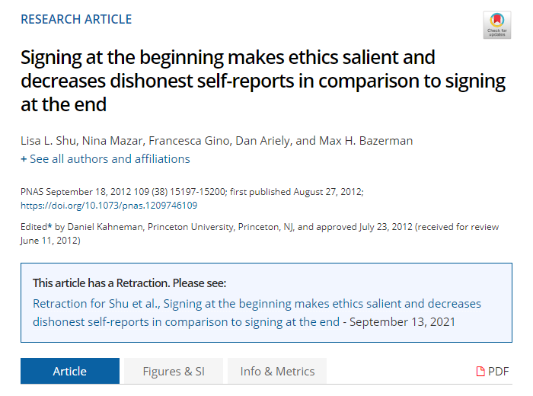
Dishonesty in dishonest paper
Fraud Detection in Academia
Evidence
Retraction
New paper
Notes:
Do you remember Dan Ariely? The guy who said big data is like teenage sex
The original paper found that if we ask people to sign a statement of honesty at the top of a document, instead of the bottom of a document, it’s likely that people will be more honest.
However, in the 2020 paper, he shot himself in the foot, he said that he cannot replicate the original finding, both exactly and conceptually.
Interestingly, this time they posted the data from the last time as well, and this is well it gets interesting.
A group of researchers did a deep dive into the dataset, and found many anomalies. (go into the data colada post)

Slide 12
Learning Objectives
Define the term measurement as it is used in marketing research
List the four scales (levels) of measurement
Name some widely used attitude scaling techniques in marketing research
List some other key decisions to be made when designing scales
Explain the concept of validity as it relates to measuring instruments
Notes:
Chapter 12

Slide 13
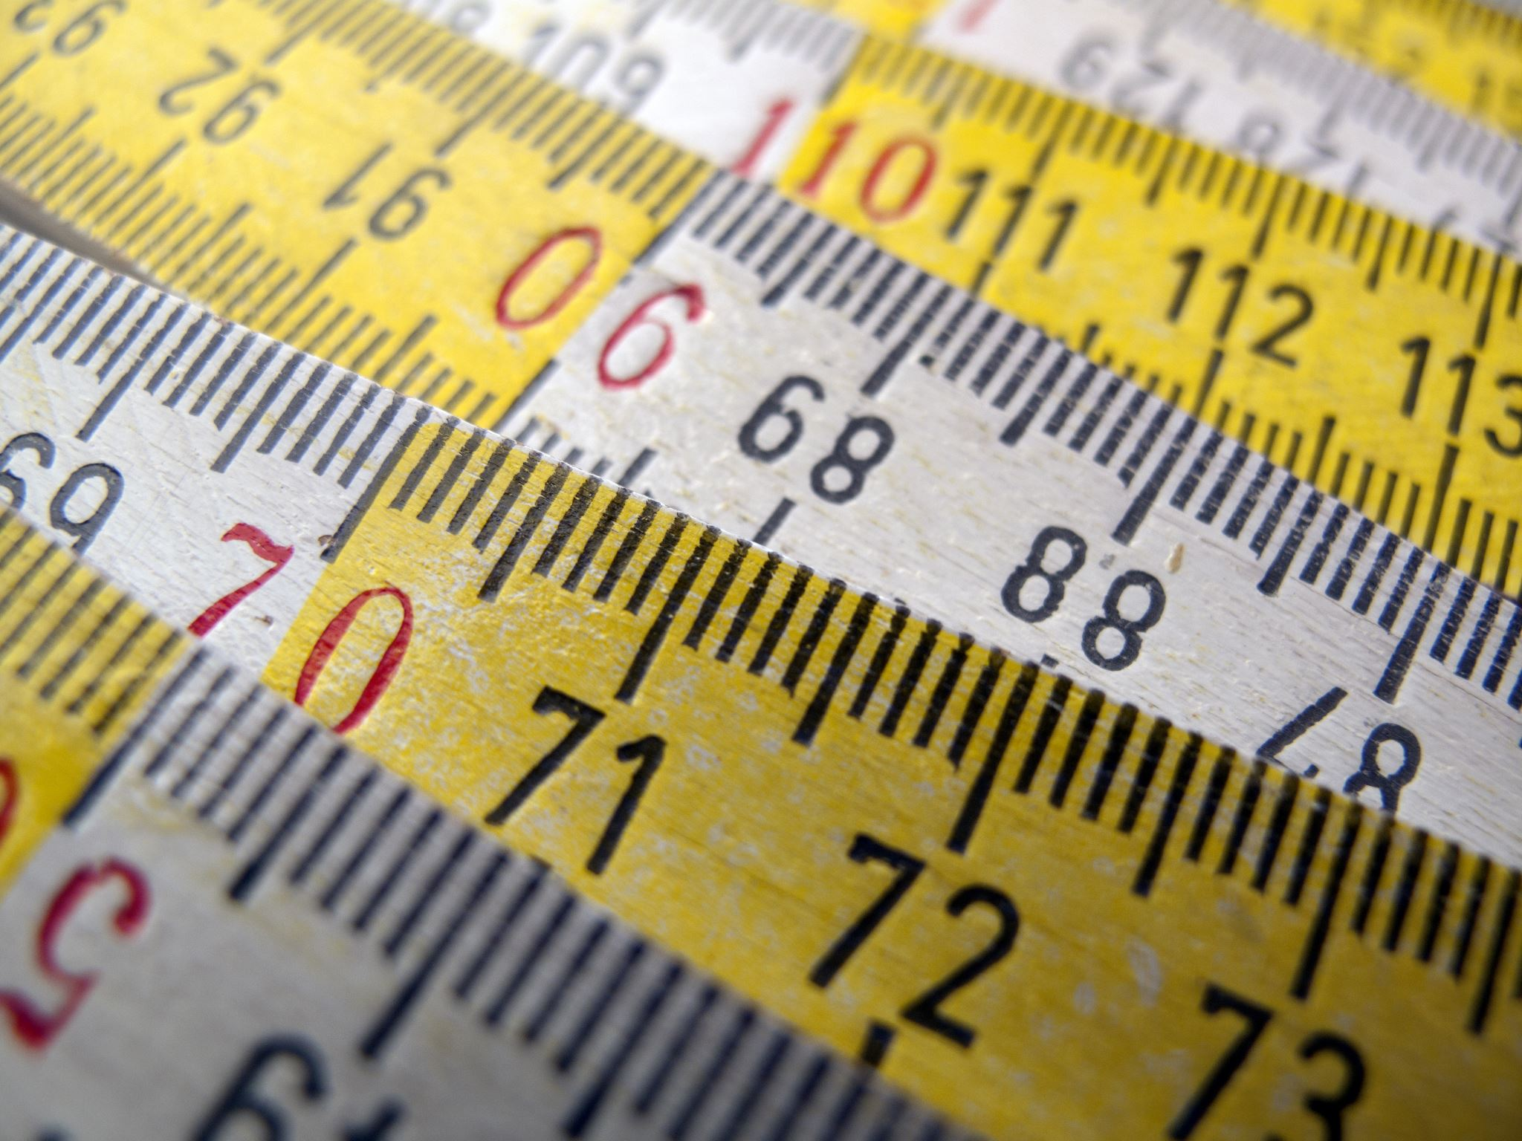
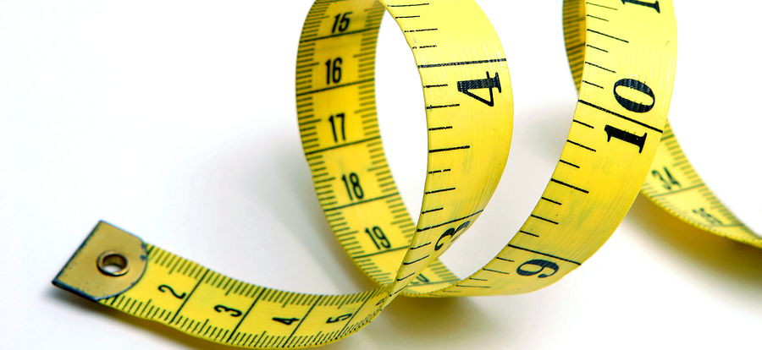
Measurement
“rules for assigning numbers to objects in such a way as to represent quantities of attributes” Bennett (1995).
Measurement vs. Variable?
This Photo by Unknown Author is licensed under CC BY-SA
Notes:
Source: Peter D. Bennett, ed., Dictionary of Marketing Terms, 2nd ed. (Chicago: American Marketing Association, 1995), p. 173.
Measurement is determining how much of a property is possessed by the entity you are measuring. Entity in our case can be customer, brands, stores, advertisements etc.
Measurement vs. the variable?
measurement is amount of information within a variable.

Slide 14
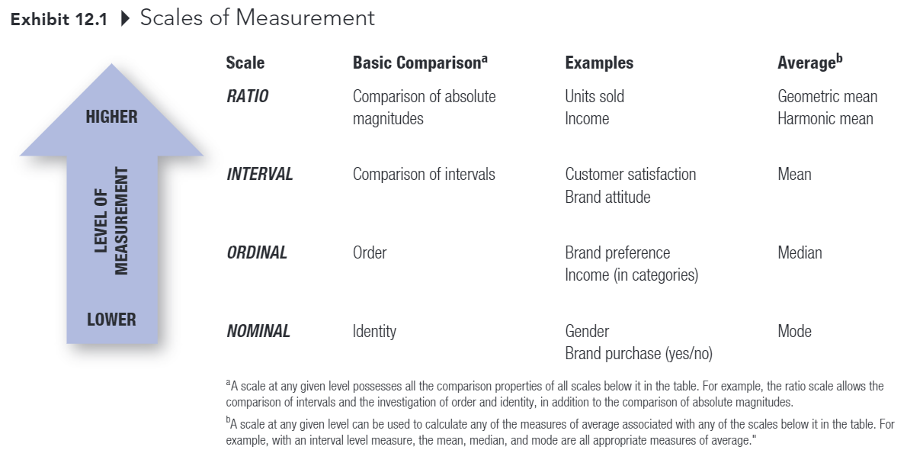
Measurement
Notes:
There are 4 types of scale for measurement
Can someone help me define mode, median, mean, and geometric mean?

Slide 15
Measurement
Higher levels of measurement have all the properties of lower levels of measurement
Nominal scale: measurement in which numbers are assigned to objects or classes of objects solely for the purpose of identification (e.g., which is your fav soft drinks? Coke, Dr. Pepper, etc.)
Ordinal scale; measurement in which numbers are assigned to data on the basis of some order (e.g., more than) of the objects (e.g., rank your fav drinks in descending order).
Notes:
At the lowest level, we have nominal scale, which is usually used for identity such as gender or brand purchase, the average will be mode
On the second level, we have ordinal scale, which is in in its name you measure a variable in a specified order such as brand preference, you rank your preference from Walmart shoes to Nike shoes, we have median as an average

Slide 16
Measurement
Interval scale: measurement in which the assigned numbers legitimately allow the comparison of the size of the differences among and between members (e.g., Coke from extremely unfavorable … favorable).
Ratio scale; measurement that has a natural, or absolute, zero and there allows the comparison of absolute magnitudes of the numbers (e.g., how many ounces of Coke do you consume per day?)
Notes:
On the next level, we have interval where we can use for comparison of intervals (this might be hard to understand at first), but I think you can understand with examples such as customer satisfaction, or brand attitude, you can rank it from a scale of 1 to 5, or 1 to 7. Then you can calculate the average by taking the mean
And the highest level of measurement is ratio, such as units sold, or income,
The difference between interval and ratio scales comes from their ability to dip below zero. Interval scales hold no true zero and can represent values below zero. For example, you can measure temperature below 0 degrees Celsius, such as -10 degrees. Ratio variables, on the other hand, never fall below zero.
An interval scale, however, has a zero point with an arbitrary presence. This means that the value of zero has no real meaning.
the distance between two variables in a ratio scale is also equal in distance. In addition, a ratio scale has a true zero point, meaning the value of zero is not arbitrary

Slide 17
Why the Level of a Measurement Scale Important
The scale affects what may or may not be said about the property being measured
Which statistical analysis will be useful
Examples:
If you which to calculate an average, you must use an interval or ratio scale
If you have a nominal or ordinal scale, you must summarize the results with a percentage or frequency distribution

Slide 18
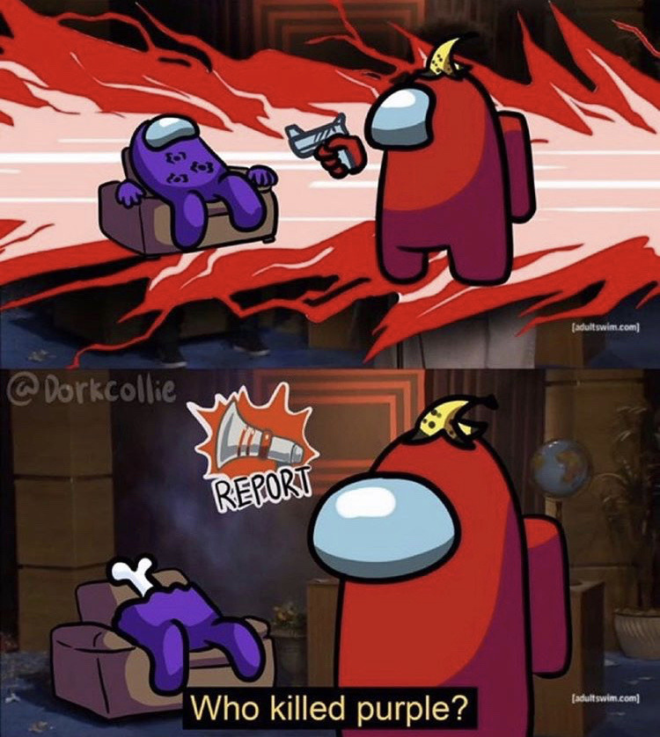
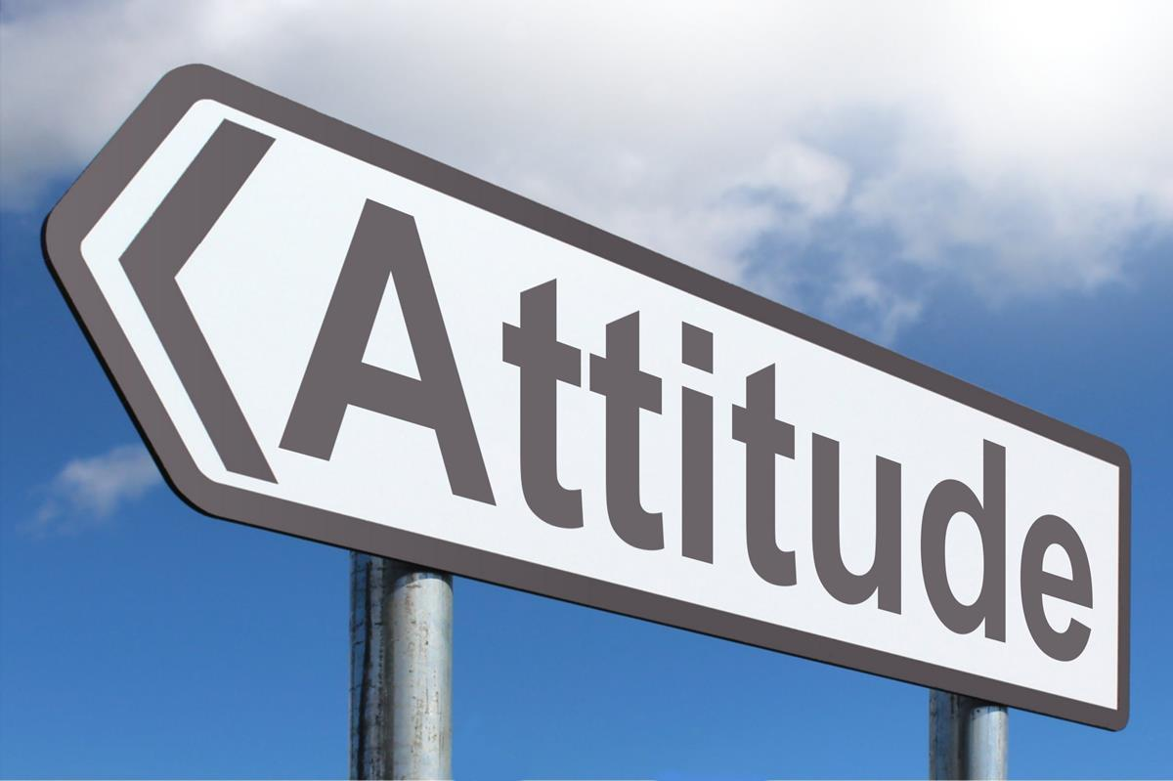
Measuring Attitudes and Other Unobservable Concepts
Self-report: A method of assessing attitudes in which individuals are asked directly for their beliefs about or feelings toward an object of class of objects. (most common approach to measuring attitude)
This Photo by Unknown Author is licensed under CC BY-SA
Notes:
Attitude is one of the 7 types of primary data
To measure attitude, we use self-report method which is…

Slide 19
Three General Types of Self-Report Attitude Scales
Itemized-Rating Scales
Graphic-Rating Scales
Comparative-Ratings Scales
Notes:
There are three general types of self-report attitude scales

Slide 20
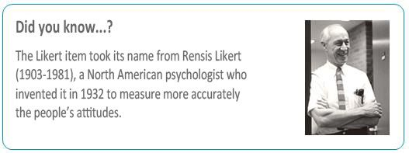
Itemized-Rating Scales
A scale on which individuals must indicate their ratings of an attribute or object by selecting the response category that best describes their position on the attribute or object (e.g., Likert Summated-Rating Scales, Semantic Differential Scales)

Slide 21
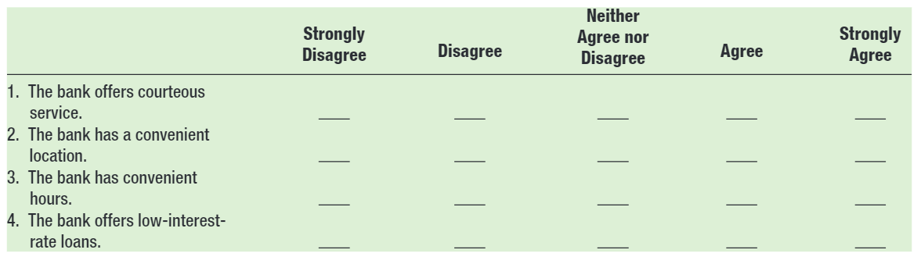
Summated-ratings Scale
A self-report technique for attitude measurement in which respondents indicate their degree of agreement or disagreement with each of a number of statements

Slide 22
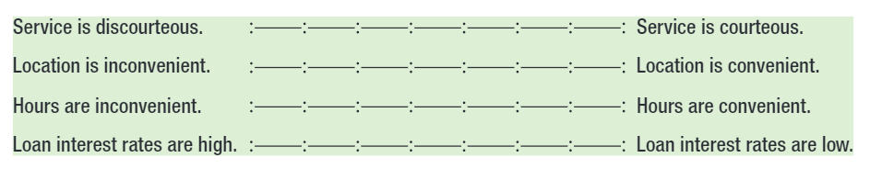
Semantic-differential Scale
A self-report technique for attitude measurement in which the subjects are asked to check which cell between a set of bipolar adjectives or phrases best describes their feelings toward the object.

Slide 23
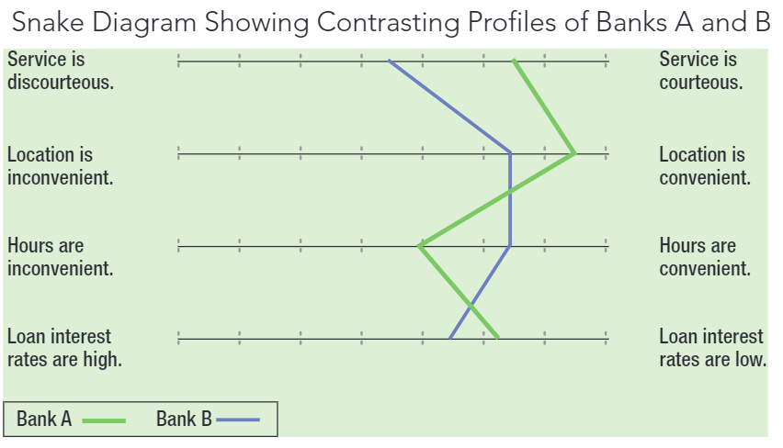
Snake Diagram

Slide 24
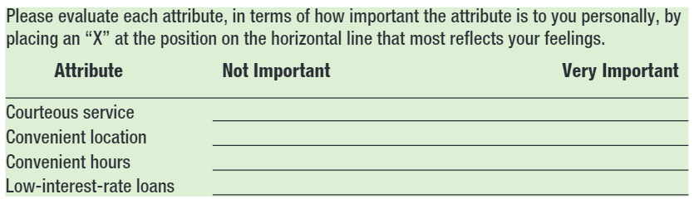
Graphic-Ratings Scales
A scale in which individuals indicate their ratings of an attribute typically by placing a check at the appropriate point on a line that runs from one extreme of the attribute to the other
Notes:
The second type of self-report attitude scale is graphic-ratings scales

Slide 25
Comparative-Rating Scales
A scale requiring subjects to make their ratings as a series of relative judgments or comparisons rather than as independent assessments.
Notes:
And the last type of self-report attitude scale is comparative-rating scales
It might be easier to think of examples

Slide 26
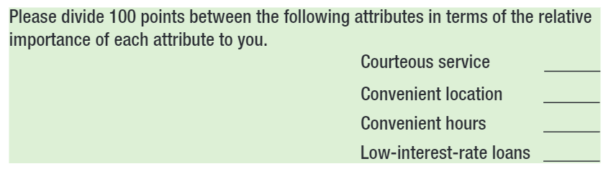
Constant-sum Method
A comparative-ratings scale in which an individual divides some given sum among two or more attributes on a basis such as importance or favorability
Notes:
A form of comparative-ratings scale is constant-sum method

Slide 27
Other Considerations in Designing Scales
Number of items in a scale
Global measures versus composite measures
Number of scale positions
Odd or even number?
Including a “don’t know” or “not applicable” response category
Notes:
Global measure vs composite measure is related to measurement theory. But I can give you a taste of it.
Why do you think we use odd or even number of scale position? Ex: 5 vs 4
Should we include an option for don’t know or “NA”

Slide 28
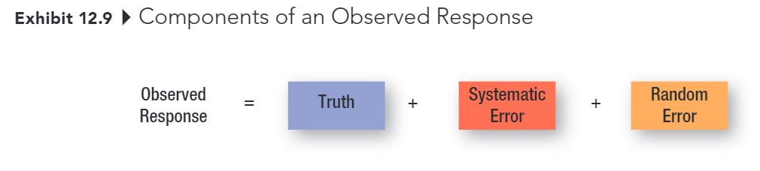
Establishing the Validity and Reliability of Measures
Notes:
Now we turn to validity and reliability of measures
How do you know what we are asking truly measure what we want to measure?
How do you know that the variable that you are measuring truly capture the latent construct that you want to measure?
So there are 3 components of an observed response
Say you of observe a person indicates that along a likert scale asking what your satisfaction level is with the gym’s machine and equipmentr, and she said 3 over 5.
That number contains …
Remember to draw

Slide 29
Error
Systematic Error
Error in measurement that is also known as constant error because it affects the measurement in a constant way
Random Error
Error in measurement due to temporary aspects of the person or measurement situation that affects the measurement in irregular ways.
Notes:
Random error is also known as unsystematic error.
I think a visualization will be better to understand the difference between the two errors

Slide 30
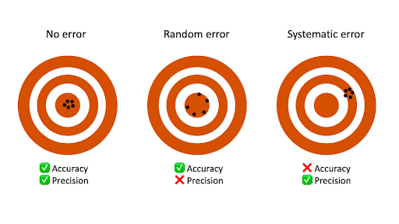
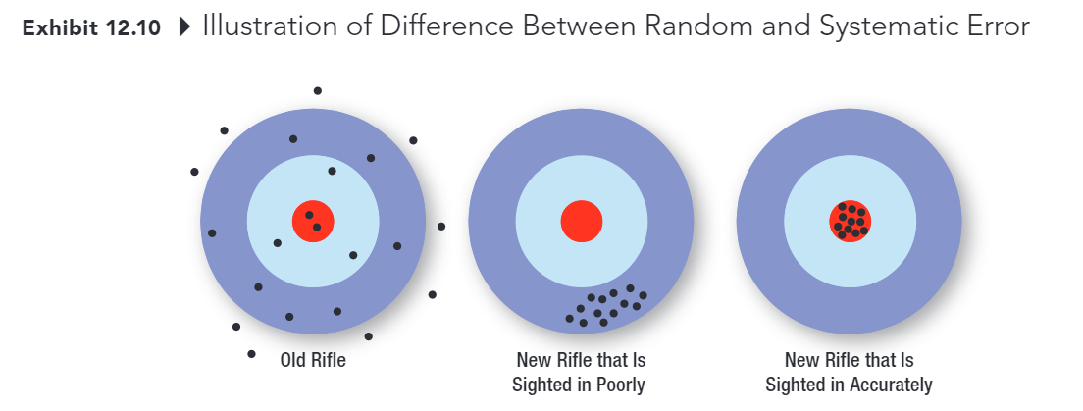
Difference between Random and Systematic Error

Slide 31
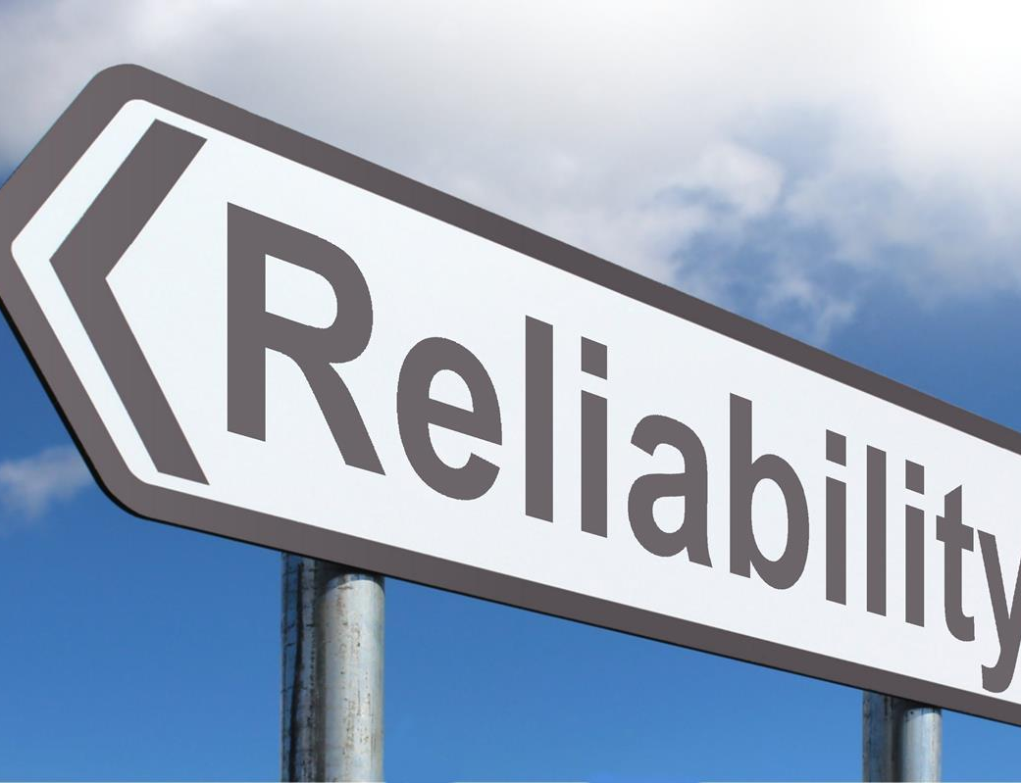
Reliability
Ability of a measure to obtain similar scores for the same object, trait, or construct across time, across different evaluators, or across the items forming the measure
This Photo by Unknown Author is licensed under CC BY-SA
Notes:
If you measure the same person’s personality trait.
The researchers found that individuals' levels of each personality trait, relative to other participants, tended to stay consistent within each decade of life. That pattern of consistency begins around age 3, and perhaps even earlier

Slide 32
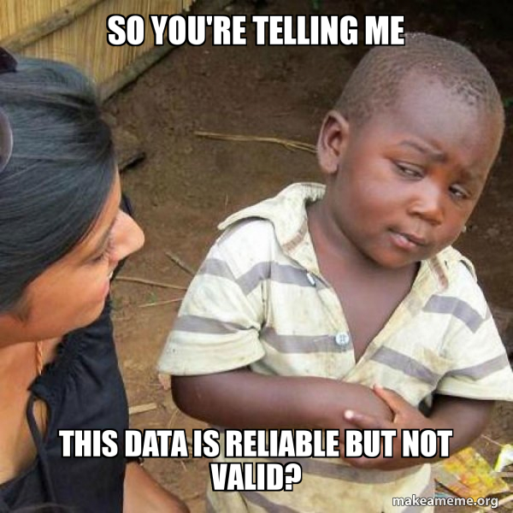
Validity
The extent to which differences in scores on a measuring instrument reflect true differences among individuals, groups, or situations in the characteristics that it seeks to measure or true differences in the same individual, group, or situation from one occasion to another, rather than systematic or random errors.

Slide 33

Validity
Unreliable Not Valid
Reliable Not Valid
Reliable Valid
Notes:
A measure can be reliable but not valid
A valid measure must be reliable.

Slide 34
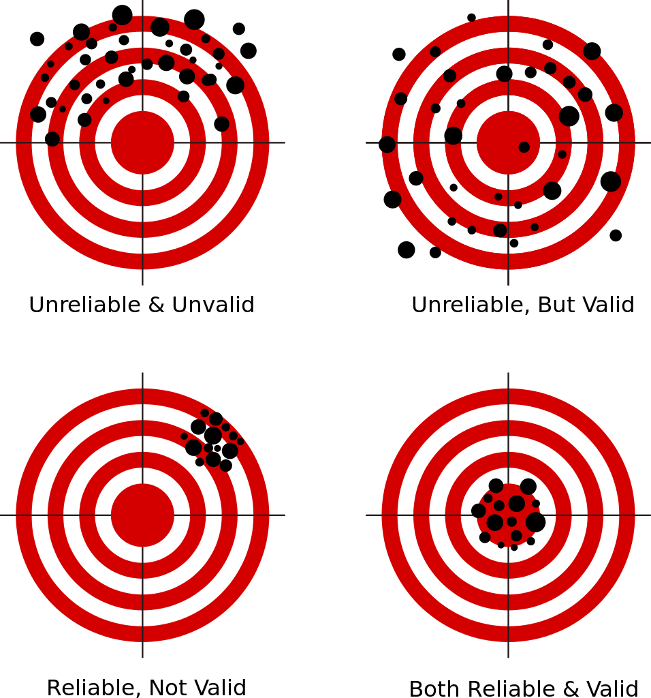
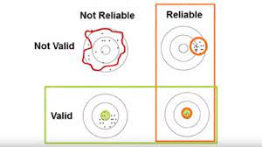
Reliability vs. Validity
This Photo by Unknown Author is licensed under CC BY-SA

Slide 35
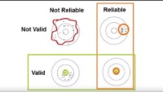
Reliability vs. Validity
Notes:
Watch this video later to digest it.

Slide 36
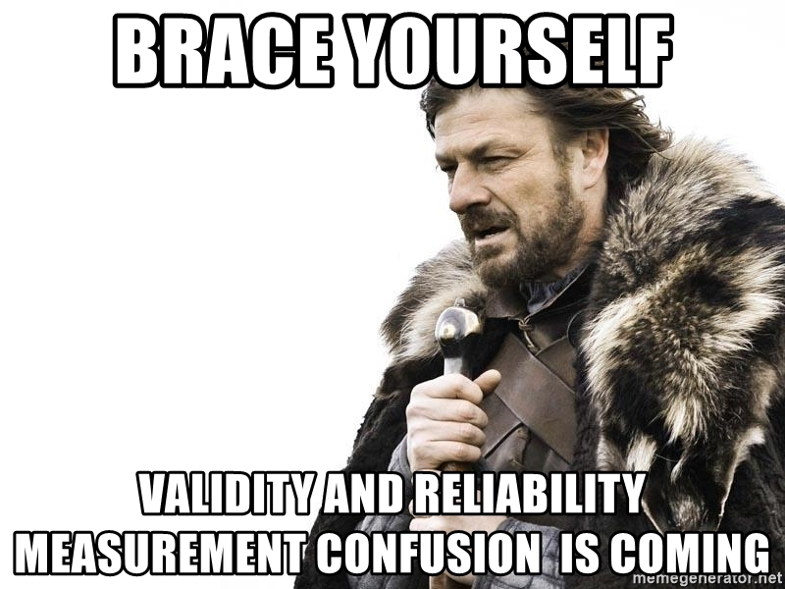
Questions

Slide 37
Recap
Measurements
Scales
Reliability
Validity

Slide 38
Qualtrics Homework
Did you read the instruction and start working on this homework?
Nah, I am chillin. It can wait. I think I can do it on Sunday.
I read it. But I have questions.
I read it, understood the instruction, and am working on it
I almost finish it.

Slide 39

Discussion Case #4
The Red Lion
A restaurant owner with 4 alternatives
You have to help him pick one

Slide 40
15-min Group Discussion
PA #4: Design a questionnaire
Sign-up Sheet
Questionnaire Tip
Items to be submitted
Notes:
Go over example questionnaire (especially the message section)
Go over item 3 (you should look at my comment from assignment 3.5)

Slide 41
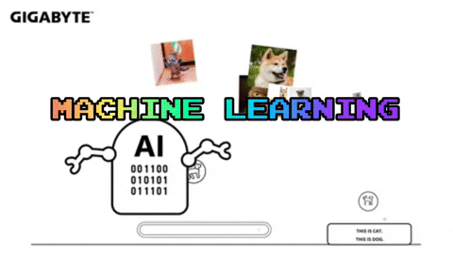
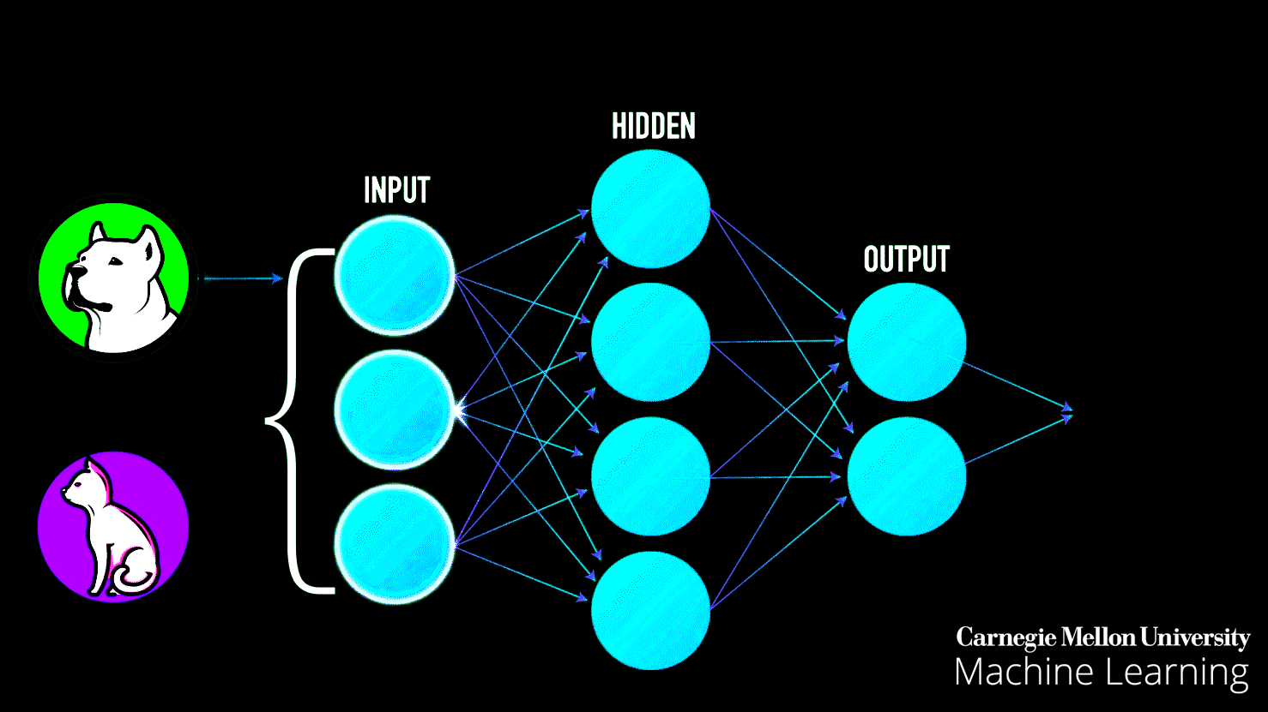
5-min snippet
Simple Machine Learning
Search strategy
Evolutionary strategy
Notes:
The model creates a set of turtles whose goal is to get to the upper right corner of the world.
The turtles start with random strategies, but the model then uses an evolutionary approach they improve their strategies over time to reach this corner.
Model creates 20 agents, and each agent has a strategy to a random set of five input/operator combination (heading and Xcor)
Each strategy results in the turtle changing its heading.
When running the model, each agent executes their strategy 25 times, moves forward 1 after execution of its strategy, and measure its fitness.
On the basis of this measurement, the worst 75% of the turtles in terms of performance are killed and replaced by mutated copies of the top performing 25%
Then the process is then repeated
The BEST FITNESS monitor shows the maximum fitness for agents in the current generation.
Fitness is defined here as the distance between the turtle and its goal, expressed as a negative value: the closer this value is to zero, the closer the turtle is to the goal, and thus, the more “fit” it is.
The AVERAGE FITNESS VS. TIME plot shows the evolution of the average fitness of the whole population, which should increase over time.

